Slide 1
Machine Earning
A Story of Abandoned Ideas

Slide 2
Project: Sentient ODS
Goal: Improve Performance of ODS, i.e. improve ODS such that it beats the previous best score on the FRAMES benchmark.

Slide 3
Ideas
-Adjust LLMs for code generation and Reasoning
-Add third LLM as a prompting model for code generation model (Triple agent system)
-Redistribute actual tasks of the different LLMs
-Implement new web scraping software to improve information retrieval
-Prompt engineering for the individual LLMs

Slide 4
Conclusion
Most of it did not work -> So most of it was abandoned in the end

Slide 5
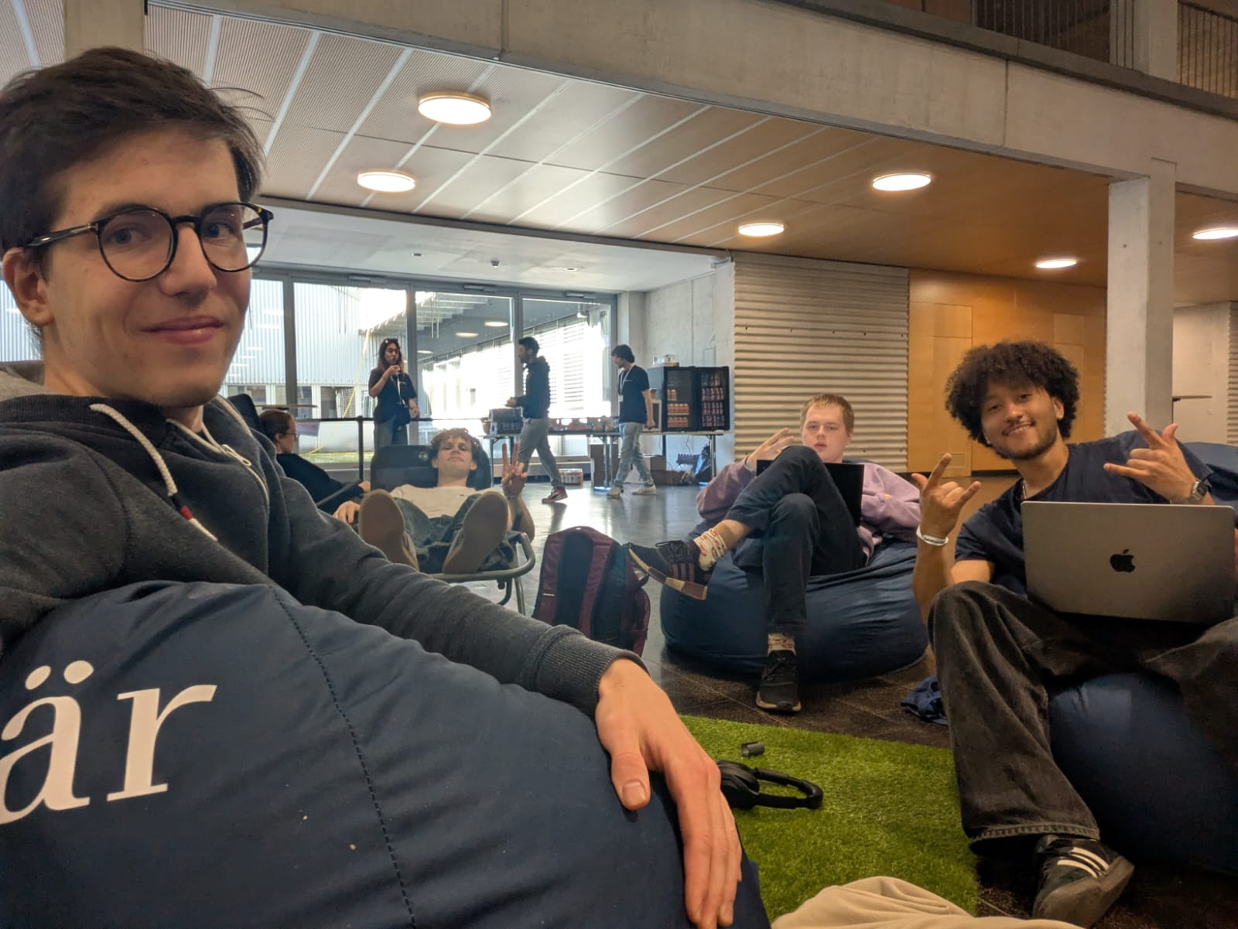
Team Picture

